Slide 1


Social Economy Space: a hub for social economy research
Roger Gillis
Archivist, Mount Saint Vincent University
Stan Orlov
Systems Librarian, Mount Saint Vincent University
Victoria Volkanova,
Chef du Service des systèmes informatisés
Université de Moncton
www.socialeconomyatlantic.ca

Slide 2
Introduction
Research outputs from research projects, especially those that are not commercially published (often referred to as grey literature), may often not be made accessible after a research project is completed.
The Social Economy Space (SE space) is an online repository of resources that attempts to address this issue by providing free access to research and resources related to the Social Economy, with a focus on Atlantic Canada.

Slide 3
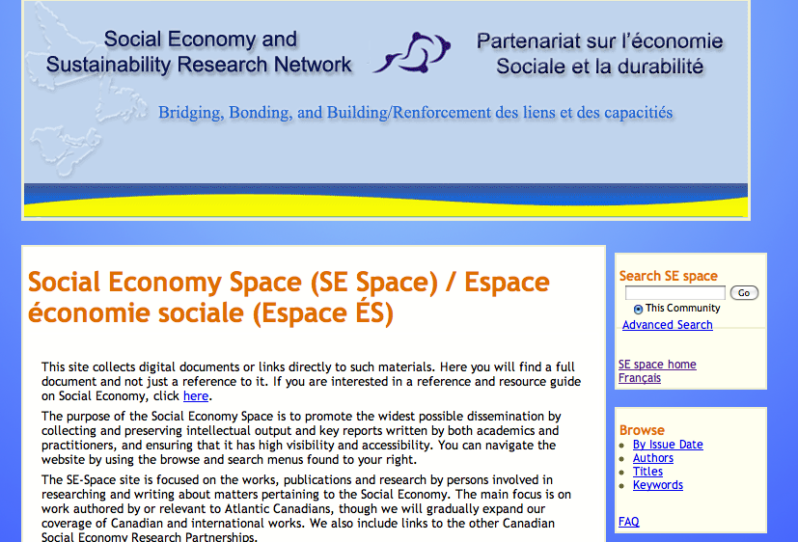
Social Economy Space (SE space) www.socialeconomyatlantic.ca

Slide 4
Social Economy & Sustainability Research Network (SESRN)
A group of researchers from academic institutions, community organizations and various levels of government, who have come together to explore the Social Economy in Atlantic Canada.
Atlantic Network is one of six such regional research networks across Canada.
University researchers partner with community economic development organizations, non-profits, service sector organizations and co-operatives of a local, regional and national scope.

Slide 5
Social Economy & Sustainability Research Network (SESRN)
Employing, mentoring, and involving students in social economy research a top priority of the network.
Two of the member institutions’ libraries (Mount Saint Vincent University and Université de Moncton, in consultation with the SESRN directors developed a repository for the project.

Slide 6
About the Project: Université de Moncton
Université de Moncton, location of a sub-project of the SESRN:
Mobilization for Natural Resources and Livelihoods, under the direction of Dr. Omer Chouinard, which focused on natural resources of New Brunswick.
Université de Moncton Library, Champlain Library: Collaborated with MSVU Library in the construction of the French side of SE space and in encouraging french submissions to the repository

Slide 7

About the Project: Mount Saint Vincent University (MSVU)
Mount Saint Vincent University: SE space was developed by the MSVU Library as part of the MSVU Digital Commons, the MSVU Institutional Repository.
The MSVU Collaborated with the director of the Atlantic Regional Network director, Dr. Leslie Brown, and her team to build the SE space.

Slide 8
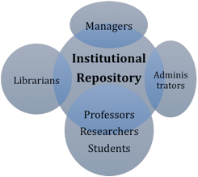
Institutional Repositories

Slide 9

Technology
SE space was created using DSpace software

Slide 10
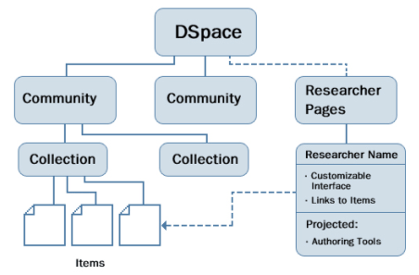
Technology

Slide 11
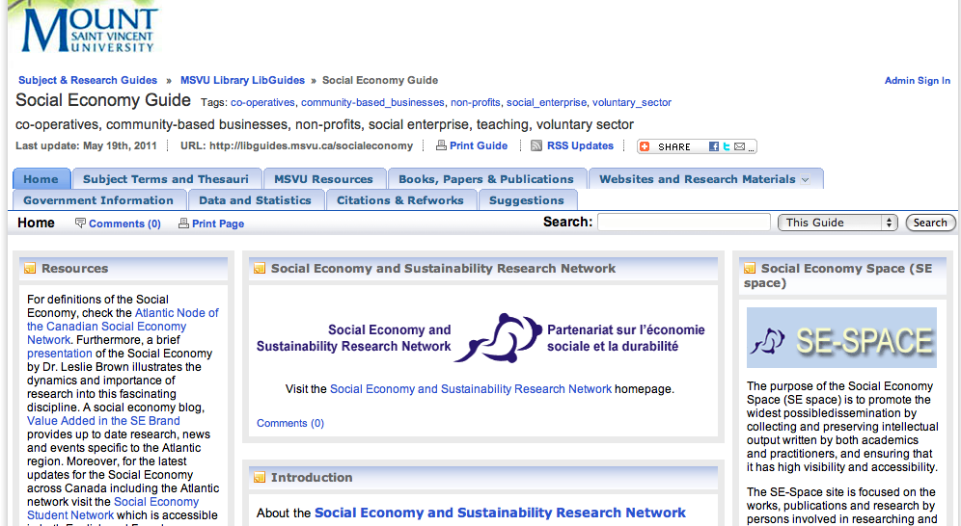
Social Economy Libguide
http://libguides.msvu.ca/socialeconomy

Slide 12
Institutional repositories
Designed to capture, preserve, and provide access to the research output of a community
Common examples of resources stored in repositories are theses and dissertations, articles, reports, and conference papers . Also can contain different formats such as audio and video files
Several types of repositories: research repository, subject-based repository, institutional repository, and subject-based repository

Slide 13
SE space as a repository
Contains both academic and non-academic works
Works in SE space are written by academics and social economy sector organizations such as community organizations and cooperatives
Works in SE space are in both English and French and in a multitude of formats (PDF, powerpoint, mp3)

Slide 14

Grey Literature
Works produced by government, academia, business, and industry that are not commercially published (Luzi, 2000)
Can include theses and dissertaitons, working papers, technical reports, conference proceedings, presentations, and a number of other forms

Slide 15

Open Access

Slide 16
Green Open Access
Open Access
Paying a journal or publisher to publish an article in a journal, at a cost to the author or institution.
Gold Open Access
Paying a journal or publisher to publish an article in a journal, at a cost to the author or institution.

Slide 17



Subject-based Repositories
Authors deposit works from particular discipline into a repository allowing for open access to their research

Slide 18
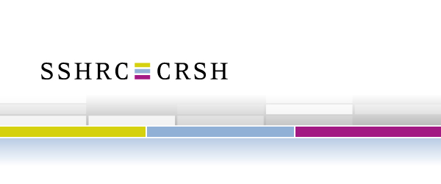



Adherence to Funding Bodies Guidelines
Notes:
Most public funding bodies are now either requiring or encouraging Open Access as a preferred method of research dissemination.

Slide 19
Visit SE space:
http://www.socialeconomyatlantic.ca

Slide 20
References
Armbruster, C., & Romary, L. (2010). Comparing Repository Types. International Journal of Digital Library Systems, 1(4), 61-73. doi:10.4018/jdls.2010100104
ACRL Research Planning and Review Committee.(2010). 2010 top ten trends in academic libraries: A review of the current literature. College & Research Libraries News. 71(6), 286-292. http://crln.acrl.org/content/71/6/286.full.pdf+html
Canadian Association of Research Libraries. (2009). Summary of Survey Results: May 2009. Retrieved from: http://www.carl-brc.ca/orjects/institutional_repositories/pdf/survey_results_2009-e.pdf
Directory of Open Access Repositories. (2011). About OpenDOAR. Retrieved from http://www.opendoar.org/about.html
Duraspace. (2011). About Dspace. Retrieved from http://www.duraspace.org/about_dspace
Social Economy and Sustainability Research Network. (2011). Social Economy Space Retrieved from http://www.socialeconomyatlantic.ca
Farace, D. J. (1997). Rise of the phoenix: A review of new forms and exploitations of grey literature. Publishing Research Quarterly, 13(2), 69-76. doi:10.1007/s12109-997-0019-7
Harnad, S. (2006) Opening Access by Overcoming Zeno's Paralysis. To appear in:
Jacobs, N., (Ed) Open Access: Key Strategic, Technical and Economic Aspects. Chandos Publishing (Oxford) Limited, Chapter 8. http://eprints.ecs.soton.ac.uk/12094/2/harnad-jacobsbook.pdf
Jeffery, Keith G. “Open Access: An Introduction” ERCIM News 64 (January 2006): 16-17. http://www.ercim.eu/publication/Ercim_News/enw64/jeffery.html
LaFleur, L., Nathan. (2004). Making Grey Literature Available through Institutional Repositories. Sixth International Conference on Grey Literature. Retrieved from http://opensigle.inist.fr/bitstream/10068/697849/2/GL6%2c_Rupp_et_al%2c_2005%2c_Conference_Preprint.pdf
Luzi, D. (2000). Trends and evolution in the development of grey literature: a review. International Journal on Grey Literature, 1(3), 106-117. doi:10.1108/14666180010345537
Lynch, Clifford A. "Institutional Repositories: Essential Infrastructure for Scholarship in the Digital Age" Association of Research Libraries: A bi-monthly report. 226(February 2003), 1-7. Retrieved from http://www.arl.org/resources/pubs/br/br226/br226ir.shtml
Mount Saint Vincent University Library. (2011). MSVU Digital Commons Retrieved from http://dc.msvu.ca
Directory of Open Access Repositories. (2011). About OpenDOAR. Retrieved from http://www.opendoar.org/about.html
Puffer, S. M., & McCarthy, D. J. (2008). Ethical turnarounds and transformational leadership: A global imperative for corporate social responsibility. Thunderbird International Business Review, 50(5), 303-314. doi: 10.1002/tie.20214
Salo, Dorothea. "Innkeeper at the Roach Motel." Library Trends 57, no. 2 (2008): 98-123. http://digital.library.wisc.edu/1793/22088
Scholarly Publishing and Academic Resources Coalition. (2010). Greater Reach for your Research.
http://www.carl-abrc.ca/projects/author/sparc_repositories.pdf
Seymour, D. J. (2010). In the Trenches Around the Ivory Tower: Introduction to Black-and-White Issues About the Grey Literature. Archaeologies, 6(2), 226-232. doi:10.1007/s11759-010-9130-z
Social Economy and Sustainability Research Network. (2011). Introduction to our network. Retrieved from http://www.msvu.ca/socialeconomyatlantic/English/indexE.asp
Social Sciences and Humanities Research Council. (2011). SSHRC – Connection Program. Retrieved from
http://www.sshrc-crsh.gc.ca/funding-financement/umbrella_programs-programme_cadre/connection-connexion-eng.aspx
References
Notes:
Most public funding bodies are now either requiring or encouraging Open Access as a preferred method of research dissemination.

